Slide 1


BUSY BEAVER PROBLEM
by
Or Gamliel
Ariel University
computer science department
05/08/2021

Slide 2
תכנית
פתיח
מה זה הבונה העסוק?
מכונת הבונה העסוק
מדוע קשה למצוא את הבונה העסוק?
בעיית העצירה
הוכחת הבונה העסוק
Σ(5) אלגוריתם הבונה העסוק עבור
מעורר כל כך הרבה עניין?Σ(N) מדוע
Σ(N) פונקציית

Slide 3
המשך תכנית
Σ(N) הקושי בחישוב
Σ(5) פתירת הבונה העסוק
מטרות המשנה של האלגוריתם
ספירה של מכונות טיורינג
טכניקות תאוצה
החלטות אי סיום
טכנולוגיה
וריאציות
מסקנה

Slide 4
פתיח
בעיית הבונה העסוק
Starting with a tape initialized to all zeros, what is the largest finite number of ones that a Turing Machine, which reads a binary alphabet, can write to the tape?

Slide 5
INTRODUCTION
Requires a conceptual understanding of what a Turing Machine is and does
A Turing Machine is an abstract model of computation that encapsulates the definition of computability
Structure:
  A finite set of states
  A finite alphabet
  A finite set of instructions
  An infinitely long tape of characters
Notes:
Structure
A finite set of states – the machine can only be in one state at a time during execution
A finite alphabet which the machine operates on
A finite se of instructions
An infinitely long tape of characters from the finite alphabet which maintains a current read position that moves back and forth along the tape according to the instructions

Slide 6
INTRODUCTION
Background on the Busy Beaver
Busy Beaver Function invented by Tibor Rado around 1960
It is quite easy to construct a Turing Machine that never halts given a particular piece of input
Halting Problem
With a small Turing Machine we could see the most number of characters the machine could print until halting
Notes:
Considering the previous definition of a turing machine, we can now define the busy beaver function, inverted by Tibor Rado around 1960.
It is quite easy to construct a turing machine that never halts given a particular piece of input.
In fact it is provably impossible to define an algorithm which, given a turing machine and an input tape, can definitively return whether or not that machine halts on that particular input.
This is classically known as the halting problem and is what the busy beaver is centered around.
Rado wanted to see if with a small TM he could see the most number of characters the machine could print until halting. He thought he could come out with a formula to obtain this. By obtaining this formula he could solve the halting

Slide 7
What is the Busy Beaver ?
They are 5-Tuple Turing Machines
All machines are started on initially blank tapes
A Turing Machine that writes the maximum number of 1’s for its number of state ∑(n), Rado’s function
∑(n) is the maximum number of 1’s left on the tape
S(n) maximum number of moves that can be made by n-state halting Turing Machine
Notes:
What is the busy beaver (description)
Busy beavers are 5-Tuple Turing machines (Turing machines that both write a symbol and move at each state transition),
rather than 4-Tuple Turing machines (which either write or move, but not both, at each state transition).
5-Tuple Busy Beaver are much more productive that 4-tuple busy beavers.
All machines are started on initially blank tapes and those that do not halt are not canditates
A turing machine that writes the maximum number of 1’s for its number of state ∑(n), Rado’s function
∑(n) is the maximum number of 1’s left on the tape (not necessarily consecutive on the tape) after such n-state turing machine halts
S(n) maximum number of moves that can be made by n-state halting turing machine

Slide 8
A Busy Beaver Machine
Deterministic Turing machines
Doubly infinite tape initially with blanks
Machines moves left or right and cannot remain stationary
Halting state is not counted in the total number of states
Tape alphabet
Notes:
Deterministic Turing machines
Doubly infinite tape (tape goes infinitely in either left or right direction) initially with blanks
Machines moves left or right and cannot remain stationary
Halting state is not counted in the total number of states
Tape alphabet consist of a single symbol “1” and a blank symbol

Slide 9
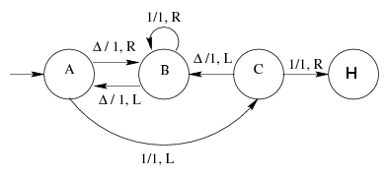
A Busy Beaver Machine
How the 3 State Machine Works
Step | State | Function
1 | A | ∆/1, R
2 | B | ∆/1, L
3 | A | 1/1, L
4 | C | ∆/1, L
5 | B | ∆/1, L
6 | A | ∆/1, R
7 | B | 1/1, R
8 | B | 1/1, R
9 | B | 1/1, R
10 | B | 1/1, R
11 | B | ∆/1, L
12 | A | 1/1, L
13 | C | 1/1, R
 | H
…
∆
∆
∆
∆
∆
∆
∆
∆
∆
∆
∆
∆
…
1
1
1
1
1
1

Slide 10
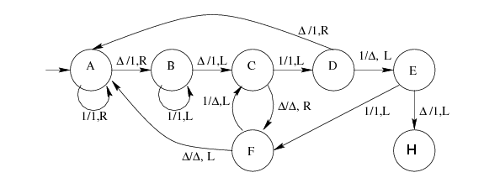
A Busy Beaver Machine
Illustration of a 6 State Machine

Slide 11
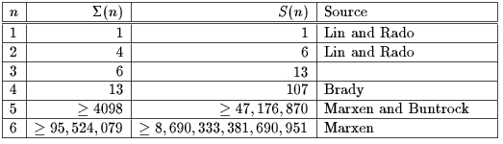
A Busy Beaver Machine
Some Busy Beaver Results
The following table gives what is know about ∑(n) and S(n) for 1 ≤ n ≤ 6

Slide 12
Why are Busy Beaver Difficult to find?
The search state is extremely large
Not possible to determine whether a particular Turing machine will halt
Neither ∑(n) or S(n) are computable functions
Notes:
Why are busy beaver difficult to fine
The search state is extremely large
Not possible to determine whether a particular turing machine will halt (the halting problem)
Neither ∑(n) or S(n) are computable functions
∑(n) and S(n) can be computed for small number of states by brute force approach

Slide 13
Halting Problem and Busy Beaver
If the halting problem were solvable then the busy beaver problem would be solvable

Slide 14

Proof on the Busy Beaver
∑(n): Is non computable
    Proof:
    1. ∑(n+1) > ∑(n) for all n
    We replace halting state adding another intermediate state:
    2. Suppose TM BB, on input 1^{n} halts with 1 ^{∑(n)} on its tape. Suppose that BB k₁ , states
    3. Build a new TM M that writes 1^{k} on its tape and then enters BB’s start state
    M halts with 1 ^{∑(k)} on its tape
    4.But M can easily be written with about + k₁ states. But this is less than k, for k sufficiently large!
    5. Hence M must produce fewer that ∑(k) 1’s
    Contradiction
…
H
…
NEW
∆/1, R
H
1/1, R
Notes:
Talk about proof for ∑(n) and S(n)
∑(n): Is non computable
Proof:
S(n) : Is non computable
Proof: There exists a TM M with n states that writes ∑(n) 1’s on its tape before halting. Such a TM must make at least ∑(n) moves. Hence S(n) ≥ ∑(n). Since ∑(n) is eventually greater than any computable function, so is S(n) is also non computable.

Slide 15
Proof on the Busy Beaver
S(n): Is non computable
    Proof: There exists a TM M with n states that writes ∑(n) 1’s on its tape before halting. Such a TM must make at least ∑(n) moves.
    Hence S(n) ≥ ∑(n).
Notes:
Talk about proof for ∑(n) and S(n)
∑(n): Is non computable
Proof:
S(n) : Is non computable
Proof: There exists a TM M with n states that writes ∑(n) 1’s on its tape before halting. Such a TM must make at least ∑(n) moves. Hence S(n) ≥ ∑(n). Since ∑(n) is eventually greater than any computable function, so is S(n) is also non computable.

Slide 16
Busy Beaver Algorithm for Σ(5)
Developed by
  1990 Heiner Marxen & Jurgen Buntrock

Slide 17
Why has Σ(N) attracted so much interest?
One of the most important result of theoretical computer science deals with the existence of non-computable functions. There are more functions than Turing Machines to compute them
To information theorist ∑(N) measures the capability of computer programs as a function of their size, as a function of the amount of information which they contain
The Busy Beaver function ∑(N) is not Turing computable function. Hence, no Turing machine can list the Busy Beaver numbers—for if it could, it could solve the Halting Problem, which we already know is impossible. ∑(N) provides another theoretic proof of the halting problem.

Slide 18
Busy Beaver function ∑(n)
∑(N), Rado’s function, is a turing machine that writes the maximum number of 1’s for its number of state
∑(N) grows faster than any computable function, therefore ∑(N) is non-computable.
As the number of n states increases the problem becomes harder and for N ≥ 5 we have several candidates which set lower bounds for ∑(N).
Value of ∑(6)
  Heiner Marxen and Buntrock ∑(6) > 1.29*10⁸⁶⁵
Values of ∑(5) found
  1983 Jochen Ludewing ∑(5) ≥ 501
  1984 A.K. Dewdney and Uhing ∑(5) ≥ 1915
  1989 Heiner Marxen and Buntrock ∑(5) ≥ 4098
Know values for small ∑(n)
  ∑(1)=1 trivial,
  ∑(2)=4 is easy to show,
  ∑(3)=6 shown by Lin and Rado,
  ∑(4)=13 shown by A.H. Brady

Slide 19
Difficulties computing ∑(N)
No one has any good theory of the behavior of Busy Beaver or Turing machines in general
Only technique of finding BB is to perform exhaustive search of all N-state TM (brute force).
Number of Turing machines on N grows exponentially
Not possible to determine whether a particular Turing machine will halt
Lower bound approach
  Perform partial search on the solution space, looking for TMs that produce the best lower bound for the value of ∑(N)
  Enumeration and simulation of (nearly) all N-state TMs
  Reduced the number of inspected machines by accelerated simulation and determining non-termination

Slide 20
Solving Busy Beaver ∑(5)
Algorithm: Enumerate all N-state TM M, and for each simulate the behavior of M, starting with an empty tape, until (1), (2), (3) or (4) happens.
  M halts. Count the ones on the tape, compare to the current record and update it
  M is proved to never halt. Forget about M.
    (Busy Beaver can be found omitting (2), however, computation of ∑(n) requires halting.
  The size of the tape exceeds a certain predefined limit. Note M to be undecided. With an appropriate representation of the tape this happens rarely.
  The number of simulation steps exceeds a certain predefined limit. Note M to be undecided.

Slide 21
Algorithm sub-goals
In order to use the algorithm to compute ∑(5) within practical time (say a month) three sub-goals must be achieve
  ENUMERATION: Not all combinatorial possible Turing machines must be considered. Marxen’s program for N=5 enumerates less than 9X10⁷ Turing Machines.
  ACCELERATION: accelerate the simulation of the behavior of the Turing Machines. The current 5-state Busy beaver does more than 4.7X10⁷ steps before it halts.
  NON TERMINATION DECISIONS: Recognition of never halting Turing machines should be efficient, happen early in the process of simulation and should be as complete as possible and necessary for N.

Slide 22
Enumeration of Turing Machines
To compute ∑(N)
  If there is a set S of TMs such that either none of them halts, or all of them halt and produce the same number of ones then it is sufficient to decide/simulate just one machine out of the set S.
If this set S can be ordered then there is a unique smallest element representing the set S.
  This equivalent sets are the basic mechanism to reduce the enumeration and computation thru a technique call Tree Normal Form (TNF)

Slide 23
Enumeration with Tree Normal Form (TNF)
Since TMs with equivalent behavior can be found then only one machine from the set S needs to be run.
TNF ensures that machines differing only in the naming of the of the states (isomorphism) or in transitions that never are used, are represented in the same way.
TNF technique reduces the search space immensely!!!

Slide 24
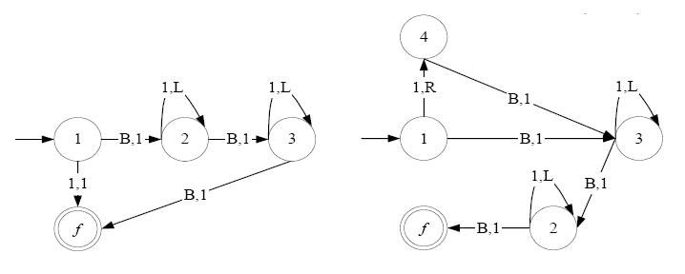
Tree Normal Form (TNF)
Example

Slide 25
Acceleration of simulation with macro machines
What is a macro machine?
  A higher level TM (macro machine) groups a bunch of the transitions (state, tape and head position) of the lower TM into a single transition (step).
Obviously the MM simulation runs a lot faster than the original lower TM.
You can also put another simulation TM (MM) on top of the MM just constructed it would also be faster than the original lower MM
MM can help to prove non halting states
There are multiple ways of constructing MM

Slide 26
Acceleration thru repetition count
TMs contain a repetitive behavior regarding both, tape contents and also transitions executed
Example:
  Suppose the state does not change, and the next 4095 macro tape symbols are all the same “111".
  These 4095 steps are repetitive, yet the MM steps are better than the original TM which required 12285 steps to accomplish the same amount of work
  Instead of writing symbol after symbol, the MM counts the blocks of repeated (equal) symbols, and into each new tape cell it writes two quantities: the symbol and its repetition count
    Write repetition counts as superscripts to the symbols on the tape:
    …111... becomes 111⁴⁰⁹⁵
  Omit exponent and move on to the next state and symbol

Slide 27
Non Determination Decision
Deciding that TM will never halt is done by predicting the behavior of the machine
  A transition will be reused for ever (forward reasoning)
    If there is a set S of states such that all transitions from elements S are defined and their target state is also in S (and the machines is in one of these state) it will never again leave S and thus not halt
    The machine produces the exact same configuration (state and tape relative to its head)
  A transition will never be used (backward reasoning)
    Define a state D that must be reached by a path
    Show that all paths to arrive at D cannot be accomplish

Slide 28
Technology
C languange
Awk
Solaris
In 1990 Heiner Marxen using his technique took about 10 days to obtain ∑(5) = 4098 with a 33 Mhz Clipper CPU
Busy Beaver Applet (One of many)
  http://wap03.informatik.fh-wiesbaden.de/weber1/turing/tm.html

Slide 29
Variations
A Busy Beaver with resulting pattern of 1’s on the tape is in a contiguous sequences with the read head located at the left most 1
4 Tuple Busy beaver
  The TM either writes a new symbol on the tape or moves its head before entering a new state (both actions are not simultaneously allowed)
  They are less productive than 5 Tuple BB

Slide 30
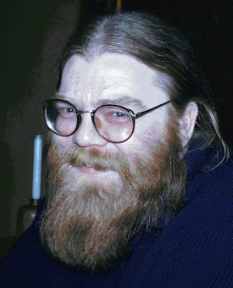

Personalities
Mr. Heiner Marxen
∑(5) and ∑(6)
Mr. Busy Beaver

Slide 31
CONCLUSION
∑(n) and S(n) can be computed for small number of states by brute force approach
Clearly, if we had an algorithm that could solve the Busy Beaver than we could very easily devise an algorithm to solve the Halting problem.
This is not the case

Slide 32
Thank You!

